Slide 1

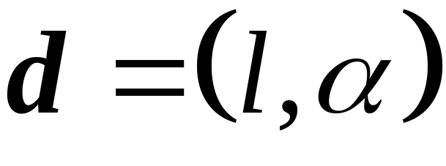



Extending a displacement
A displacement defined by a pair where l is the length of the displacement and α the angle between its direction and the x-axix can be "extended" by multiplying its "distance"
l
α

Slide 2

Thus any real number a defines an action consisting in extending the length of every displacement by a.
displacement
a new displacement
"extension" action

Slide 3







Properties of the extension action
For any displacements and and real numbers a, b, we can easily prove
stationary displacement

Slide 4
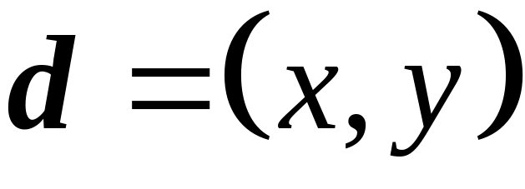
Another method of defining a displacement
y
x

Slide 5

Thus the set of all the displacements in a plane can be viewed as the set of all pairs (x, y) of real numbers. It is easy to prove that the operation ⊕ of composition of two displacements and that of an extension can be defined as follows

Slide 6







Vector space
A vector space is a set V which, together with the binary operation ⊕ forms an Abelian group and is a mapping
such that, for every , we have

Slide 7
Conventions
Sometimes we will just write V instead of
The unity element in the Abelian group is called the zero vector.
Save in cases where this might cause a confusion, we will write + instead of ⊕
Save in cases where this might cause a confusion, we will leave out the sign • for the operation of extension
The elements of a vector space V are called vectors and denoted by letters with arrows (as opposed to the real numbers, which are called scalars here).

Slide 8






Linear combination of vectors
Let and .
If , we say that is a linear
combination of the vectors
By we will denote the set of all linear combinations of vectors

Slide 9


Generating set
Let V be a vector space and G a finite subset of V. If, for every,
we have , then we say that G is a generating set for V or that G generates V.
V
G

Slide 10
Linearly independent vectors
Let V be a vector space and
If
we say that vectors are linearly independent. Otherwise we say that they are linearly dependent.

Slide 11


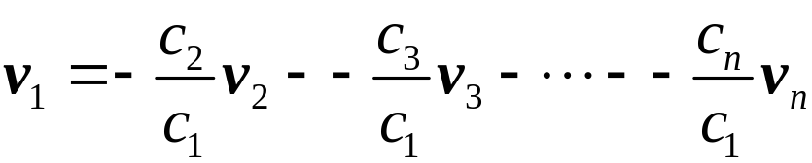

If are linearly dependent,
we can assume that, in the expression ,
say, . Then
and thus is a linear combination of
Vectors are linearly independent if and only if none of the vectors is a linear combination of the others.

Slide 12
A basis of a vector space
Let V be a vector space and B its finite subset. We say that B is a basis of V if B is a linearly independent generating set.
Bases of a vector space have the following properties:
1
Every two bases of a vector space have the same number of vectors
2
Every linearly independent subset of vectors can be comleted to form a basis
3
Every basis is a maximal independent set
4
Every basis is a minimal generating set

Slide 13




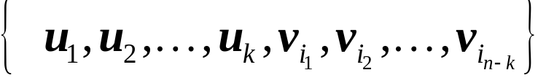


The properties of the bases of a vector space can be proved using the following Steinitz theorem:
Let be a basis of a vector space V.
Let be an independent set of vectors in V.
Then and B contains (n − k) vectors such
that the set is a basis in V.
U
V
B

Slide 14


To prove the Steinitz theorem we can use the following exchange lemma
Let be a basis in V. For any non-zero vector
there exists a vector v_{i} such that
is a basis in V.

Slide 15

Dimension of a vector space
If a vector space V has a basis we say that V has dimension n or that V is an n-dimensional vector space.
The above definition is correct since any two bases have the same number of vectors.

Slide 16


Let V be a vector space with a dimension n and let
be its basis. Then, for every , there exists a unique set of real numbers {u₁, u₂, ..., u_{n}} such that
The sequence (u₁, u₂, ..., u_{n}) is called the coordinates of vector u in basis B.

Slide 17
An n-dimensional vector space V may be identified with the vector space of all n-tuples of real numbers (u₁, u₂, ..., u_{n}) with the operations ⊕ and • defined as

